Slide 1
Smart Attendance System
Using Face Recognition
Automated, contactless classroom attendance with a live web dashboard
Team Members: V. Rohith-2520090029• Aakash Burramukku- 2520080039
•Ch. Shanthi Swaroop-2520090224
Guide: Dr M. Gayatri
Department: Department of CSIT & AIDS

Slide 2
Abstract
Manual attendance takes time and can contain errors.
Our system uses a camera to identify registered students using face recognition.
After recognition, attendance is recorded automatically with date and time.
Student and attendance details are stored in a database.
A web dashboard helps users view and manage attendance records.

Slide 3
Problem Statement
Manual roll call consumes valuable classroom time.
Maintaining attendance records manually can lead to mistakes.
Proxy attendance is difficult to control.
Searching and maintaining old attendance records is inconvenient.
A simple automated attendance solution is needed.

Slide 4
Motivation
Reduce the time spent on taking attendance.
Reduce manual errors in attendance records.
Make attendance more convenient for teachers.
Reduce the possibility of proxy attendance.
Maintain attendance information digitally.

Slide 5
Objectives
Register students with their basic details and face data.
Detect and recognize registered faces through a camera.
Mark attendance automatically after successful recognition.
Store attendance records securely in a database.
Provide a simple interface for viewing attendance.

Slide 6
Literature Survey
Face detection methods are used to locate faces in images and video.
Traditional methods such as Haar Cascade and HOG are commonly used for face detection.
Face recognition approaches compare facial features to identify a person.
Deep-learning methods such as FaceNet and ArcFace provide strong facial representations.
Previous attendance systems show that face recognition can reduce manual attendance work.

Slide 7
Research Gap
Some older systems are less reliable when lighting or face angle changes.
Many systems focus only on recognition and do not provide complete attendance management.
Some solutions require additional biometric hardware.
There is a need for a simple system combining recognition, database storage, and attendance reporting.

Slide 8
Proposed Methodology
1
Student registration
2
Capture face through camera
3
Detect and process the face
4
Compare with registered face data
5
Identify the student
6
Record attendance with date and time
7
Store and display the attendance record

Slide 9
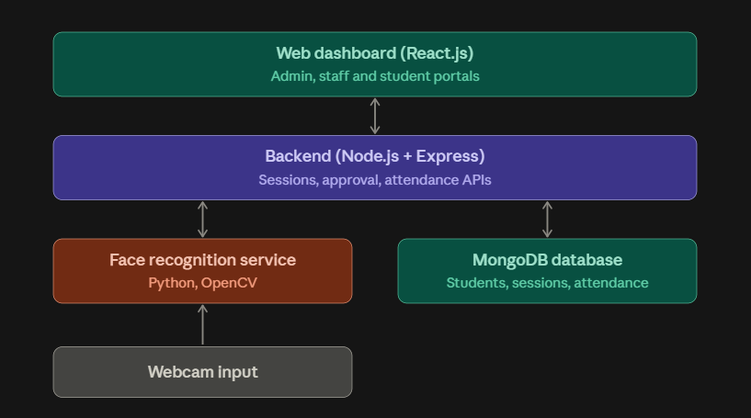
System Architecture
Data flows from camera input to the dashboard

Slide 10
Technologies Used
Frontend
Backend
Database
React.js, HTML, CSS, JavaScript
Node.js, Express.js
MongoDB
Face Recognition / CV
Development
Hardware
Python, OpenCV, face-recognition related packages
Visual Studio Code
Laptop/Desktop with webcam

Slide 11
Dataset / Input Details
Student ID and student name
Registered student face images
Live webcam/video input for recognition
Face data is used as the reference for matching
Attendance records contain student information, date and time

Slide 12
Implementation – Module 1: Student Registration
Enter student details such as ID and name.
Capture the student's face using the camera.
Process the captured face information.
Store the student details and face data.
Registered students become available for recognition.

Slide 13
Implementation – Module 2: Face Recognition
Start the camera and capture live frames.
Detect the face present in the frame.
Extract facial information for matching.
Compare the detected face with registered student data.
Display the identified student or mark the face as unknown.

Slide 14
Implementation – Module 3: Attendance Management
Receive the recognized student's ID/name.
Check whether attendance has already been recorded.
Mark attendance with the current date and time.
Store the record in the database.
Display attendance records through the dashboard.

Slide 15
Experimental Setup
Hardware
Software
Testing
Laptop/Desktop
Webcam
Visual Studio Code
Node.js
Python
MongoDB
Web browser
Registered student faces were tested using the camera.
Recognition and database attendance records were checked.

Slide 16
Results
The system detects faces using the camera.
Registered students can be recognized by the system.
Recognized students can be marked present automatically.
Attendance information is stored in the database.
The web interface provides access to student and attendance information.

Slide 17
Performance Evaluation
Recognition accuracy
Recognition response time
Correct attendance marking
Duplicate attendance prevention
Database reliability
Actual measured values should be added here after formal testing.

Slide 18
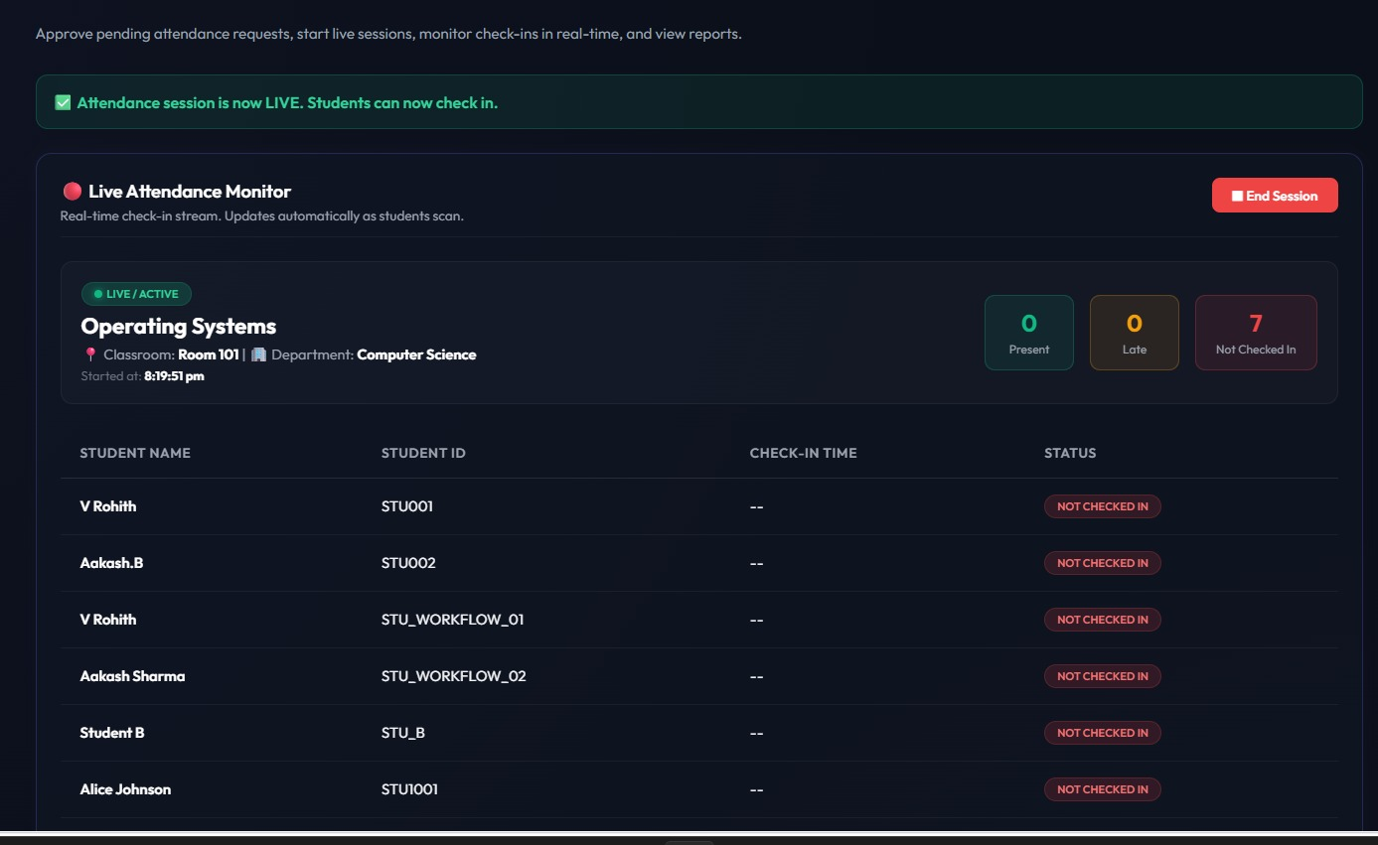
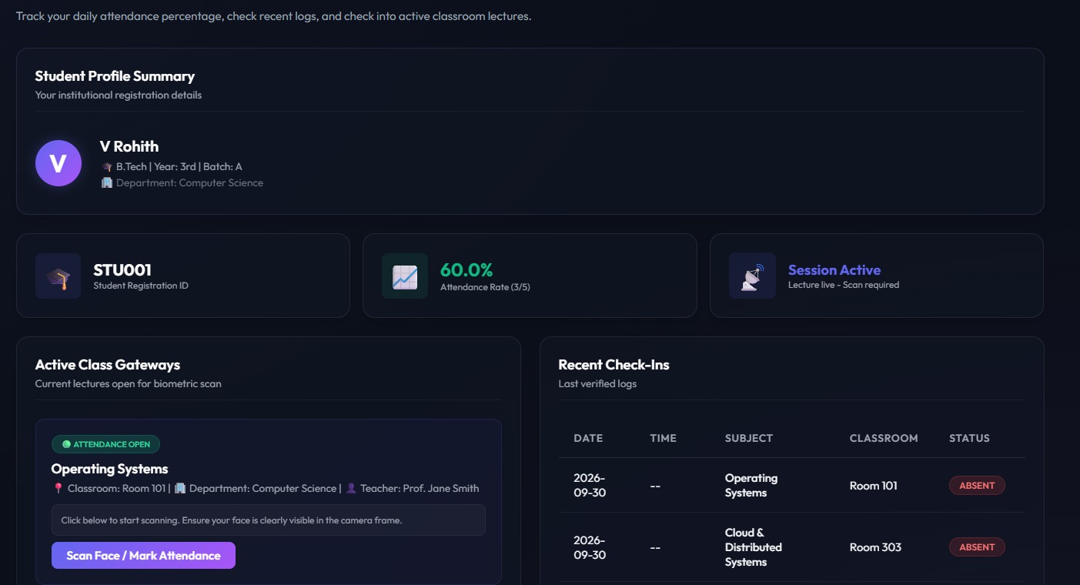
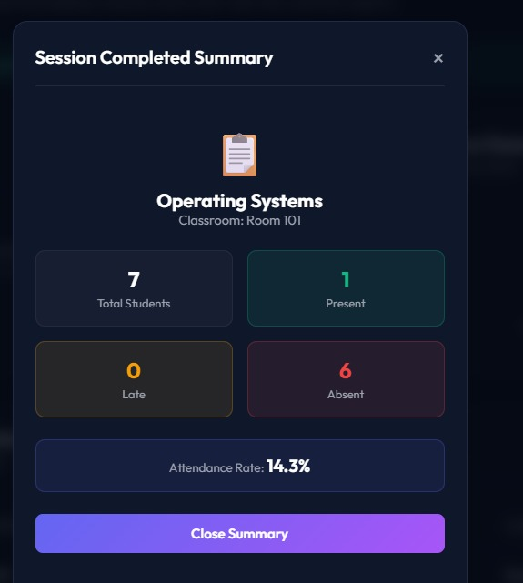
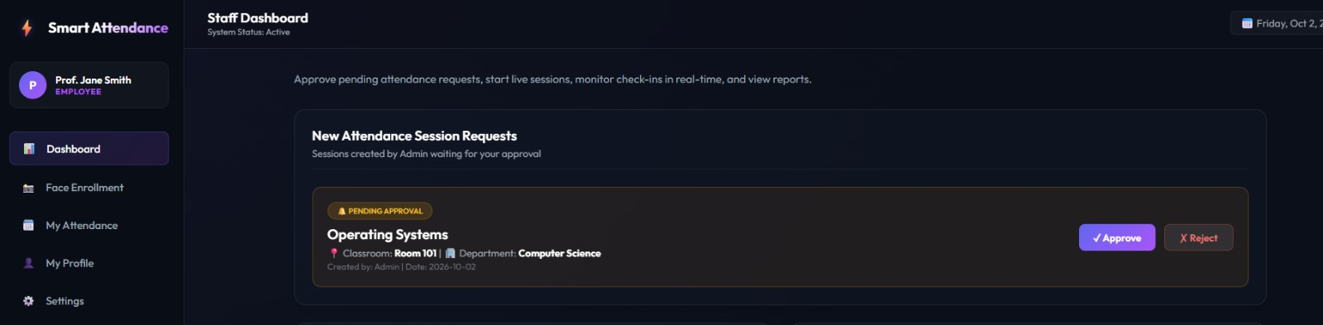
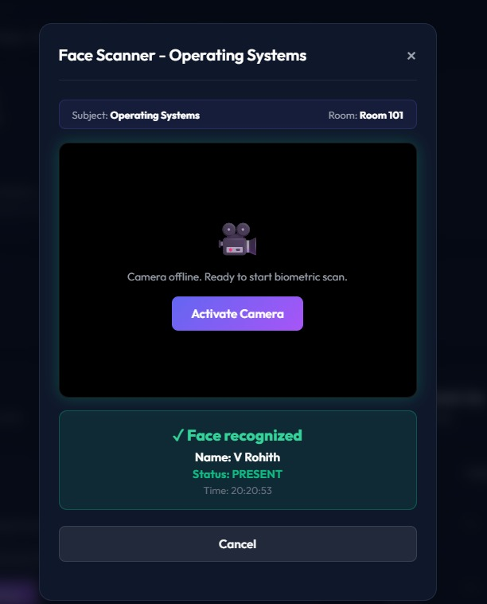
Screenshots / Working Demo
1. Staff: Live Attendance Monitor
2. Student Dashboard
3. Session Summary
4. Staff Dashboard: Session Approval
5. Face Scanner

Slide 19
Comparison with Existing System
Manual System
Proposed System
Attendance taken by roll call
More time required
Manual records
Proxy attendance possible
Face-based identification
Automatic attendance
Digital database records
Faster attendance process
Web-based viewing and management

Slide 20
Challenges & Solutions
Challenge: Different lighting conditions
Solution: Use suitable face capture conditions and preprocessing.
Challenge: Face angle variation
Solution: Capture suitable face samples during registration.
Challenge: Duplicate attendance
Solution: Check existing attendance before recording.
Challenge: Database connectivity
Solution: Connect the backend properly with the database and validate records.

Slide 21
Current Progress
Student registration module
Implemented
Face recognition module
Implemented
Backend
Implemented
Database connection
Implemented
Attendance recording
Implemented
Web dashboard
Implemented / Testing
System testing and improvements
Ongoing

Slide 22
Future Work
Improve recognition under different lighting conditions.
Improve recognition for different face angles.
Add stronger liveness/anti-spoofing support.
Generate detailed attendance reports.
Add email or notification features.
Deploy the system online for wider use.
Improve security and data protection.

Slide 23
Conclusion
The project provides an automated approach to student attendance.
Face recognition reduces the need for manual roll call.
Attendance can be recorded with student details, date and time.
Database storage makes attendance records easier to manage.
The system can be further improved for accuracy, security and scalability.
Final Outcome: Automated attendance using face recognition.

Slide 24
References
OpenCV Documentation
Node.js Documentation
Express.js Documentation
React.js Documentation
MongoDB Documentation
Face recognition and automated attendance research papers
Project source material and implementation documentation

